Slide 1
Japanese HTS PJ now and future
IEA High-Temperature Superconductivity (HTS) Workshop
"HTS Applications in the Power Sector”
30th Jan 201７
Milano
Susumu Kinoshita
Energy Conservation Technology Department
Notes:
.

Slide 2
Outline
1. Introduction
- What’s NEDO ?
NEDO’s R&D Projects on Superconductivity
2. NEDO HTS Project
- June 2016 – March 2021
2

Slide 3
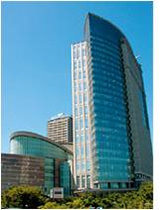
What’s NEDO ?
As Japan's largest public management organization promoting research and development as well as the dissemination of energy, environmental and industrial technologies, NEDO has a crucial mission to carry out.
Addressing energy and global environmental problems
Enhancement of Japan’s industrial competitiveness
Chairman: Mr. Kazuo Furukawa
Organization: -Incorporated administrative agency under the
Ministry of Economy, Trade and Industry (METI),
government of Japan
- Established in 1980
Location: Kawasaki City, Japan
Personnel About 920
Budget Approximately 129.8 Billion yen (2016 fiscal year)
(1.1 Billion US dollars)

Slide 4
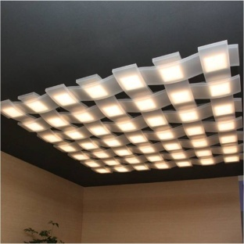

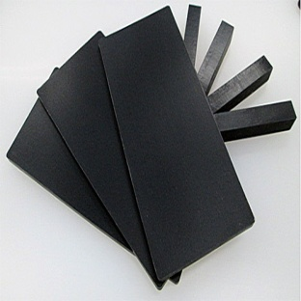
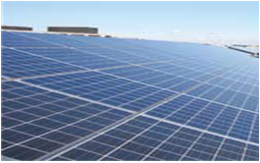
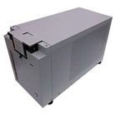
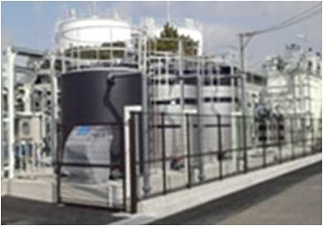

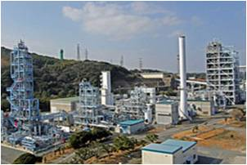
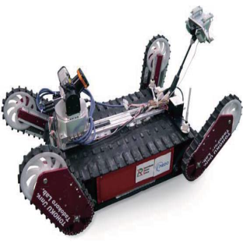
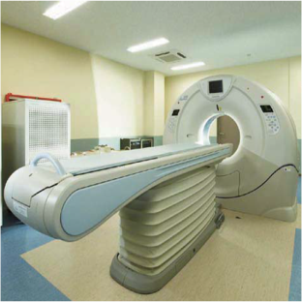
NEDO’s Technology Area
Basic Research
Technology Development
Demonstration
Energy conservation
Electronics /ICT
Materials/nanotech
Renewable energy
Energy storage
Water
treatment
Environment/ clean coal
Smart community
Bio/medical
Robotics

Slide 5
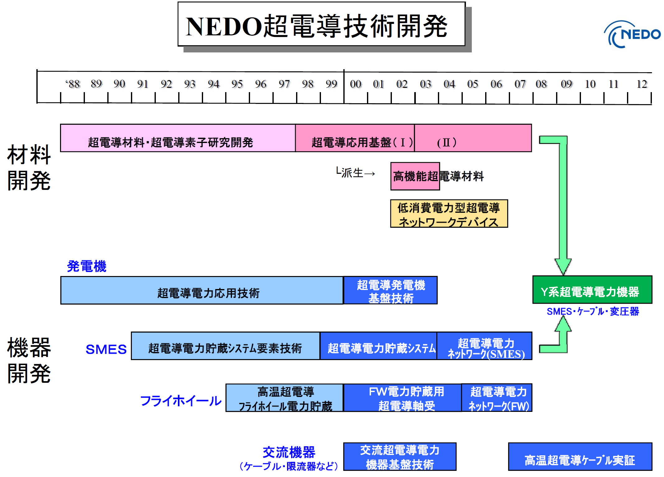

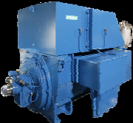

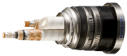
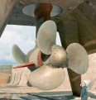
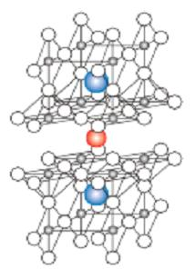
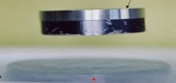
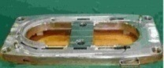
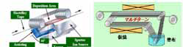
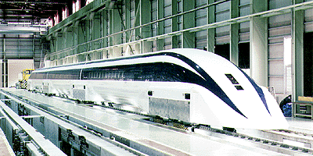
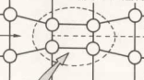
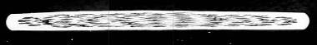
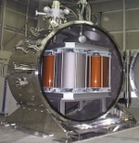
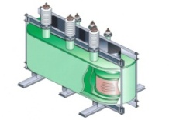
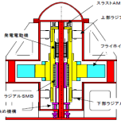
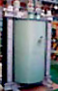
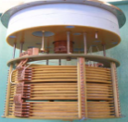
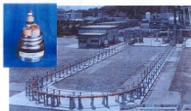
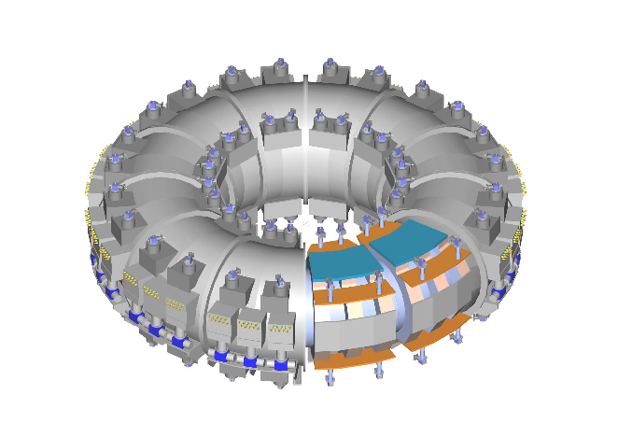
NEDO’s R&D Project on Superconductivity
Fundamental Materials Science
& Engineering
Fundamental Technologies for
Superconductivity Applications Phase I, II
YBCO C.C. etc
Reduction of Rare Earth Usage for Motors
Materials,
Science &
Processings
High J_{c}
BSCCO
Wire
MAGLEV
Generator
M-PACC
SMES, Cable( AC),
Transformer, & C.C.
Superconductive Generator Equipment(LTS)
and Materials (Super-GM)
Superconducting
Generator((SCG )
SMES
SMES system (LTS)
Basic Technology
SMES system
(LTS)
SC Power
Network
(LTS-SMES)
Power Device
Applications
Flywheel
HTS Flywheel
Energy Storage
SC Magnetic
Bearing for FW
SC Power
Network
System (FW)
AC Power Device
Cable, FCL, etc.
AC Power
SC Equipment
(Super-ACE )
Bi-Cable( AC)
( Field Test )

Slide 6
Outline
1. Introduction
- What’s NEDO ?
NEDO’s R&D Projects on Superconductivity
2. NEDO HTS Project
- June 2016 – February 2021
6

Slide 7

NEW NEDO HTS Project
“Project to Promote Commercialization of
High-Temperature Superconductivity
Technology”
Period: June 2016-Februrary 2021 5years
Budget:€68M (120yen/€ 5years)
€12.5M (2016FY)

Slide 8
Development Items and Targets
Cate gory | Items | Subsidy From NEDO | Target | Contractor
HTS Power Transmission Development | ①Commercialization Development of HTS Power transmission cable system （2016～2018） | 50% | ・Establishment of safety and evaluation standards for HTS cable system ・Establishment of high efficient cooling system ＣＯＰ：>0.11, Inspection period：40,000h ・DC power transmission : Establishment of design/operating guideline | Tokyo Power Electric HD, Sumitomo Electric Industries, Furukawa Electric Industries, Mayekawa MFG I-SPOT
 | ②Basic technology Development for applying transportation （2016～2020） | 100% | ・Establishment 2km long cooling system and demonstration cooler size : ２ｍ^{３} /kW, Pump：0.6MPa, Flow rate 50L/m ・Establishment of design/evaluation/maintenance standard | Railway Technical Research Institute
High Magnetic Field Magnet System Development | ③Technology Development of High stable Magnetic Field HTS Magnet system （2016～2020） | 100% | ・Imaging Demonstration of ３Ｔ Half size Magnet Coil system Magnetic Field uniformity <100ppm Magnetic Field stability <1ppm/ｈ ・Establishment design standard for ３T MRI coil shape, cooling ability, cryostat etc. ・Technology Development of superconducting contact （<10⁻¹²Ω） | Mitsubishi Electric Advanced Industrial Science and Technology Furukawa Electric Industries
 | ④Commercialization Development of HTS wire for High Magnetic Field Coil （2016～2018） | 100% | ・Improvement of High Magnetic Field REBCO wire： Ave current density >400A/mm2 @30K, ７Ｔ ・Ｉｃ deviation （（Ic ave.-Ic min.）/Ic ave.）< 0.15 for 1km long wire | Fujikura Advanced Industrial Science and Technology
 |  | 50% | ・REBCO wire production rate > 50m/h | Fujikura

Slide 9
Contents and Period
2016FY
2017FY
2018FY
2019FY
2020FY
HTS Power Transmission Development
①Commercialization Development of HTS Power transmission cable system
（2016～2018）
●６６ｋＶ，66kV, 275kV Establishment of safety
and evaluation standards for HTS cable system
●In-grid Operation, dismantling and research
●Design spec.
for cable
●Estimation standard
for Safety/ reliability
Promotion to Commercialization
●DC power transmission
: Establishment of design/
operating guideline
②Basic technology
Development for
applying
transportation
（2016～2020）
●Small size cooling system
●LN2 Pump
●Insulating Pipe （Cable）
●Laying long HTS
Feeder
●Estimation
●System maintenance study
High Magnetic Field Magnet
System Development
③Technology
Development of High
stable Magnetic
Field HTS Magnet
system
（2016～2020）
●Development of ３Ｔ Half size Magnet Coil system
●Establishment design standard for ３T MRI
coil shape, cooling ability, cryostat etc.
●Development 5Ｔ Half size Magnet coil system
●Imaging by 5T Half size MRI
●Technology Development of superconducting contact (<10⁻¹²Ω)
●Trial coil production by superconducting contact
/Evaluation
④Commercialization
Development of HTS
wire for High
Magnetic Field Coil
（2016～2018）
●Improvement of High Magnetic Field REBCO wire
●Improvement stability in long length
●Improvement Throughput
Putting Wire
to Practical use

Slide 10
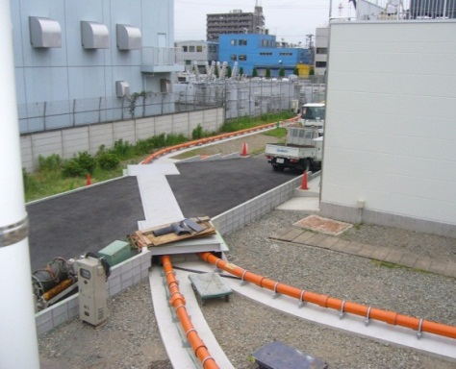
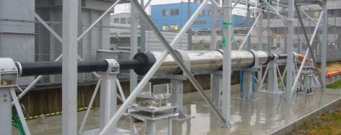
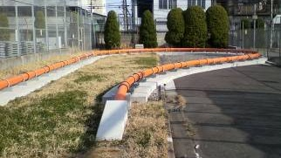
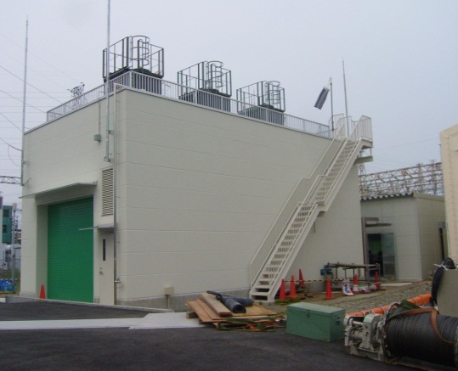
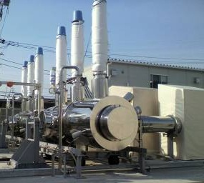
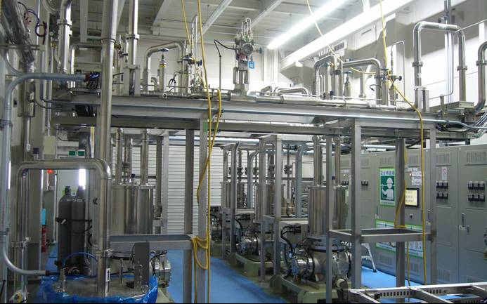
AC Transmission cable system
Joint
Cooling
system
house
Trans
154/66 kV
200 MVA
Site
office
Monitoring
house
CB2
CB1
LS2
LS1
LS3
CH
CB
Notes:
This slide shows the cable system after construction.
Cable with straight, cable with 180 degree bent,
Cable-to-cable joint, terminations, and cooling system.

Slide 11
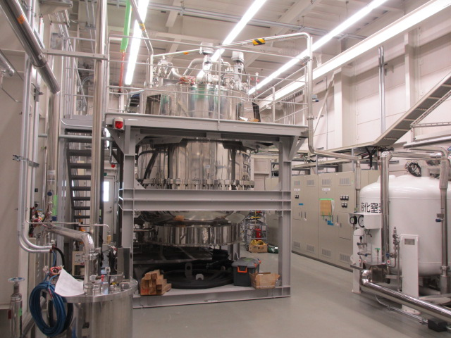
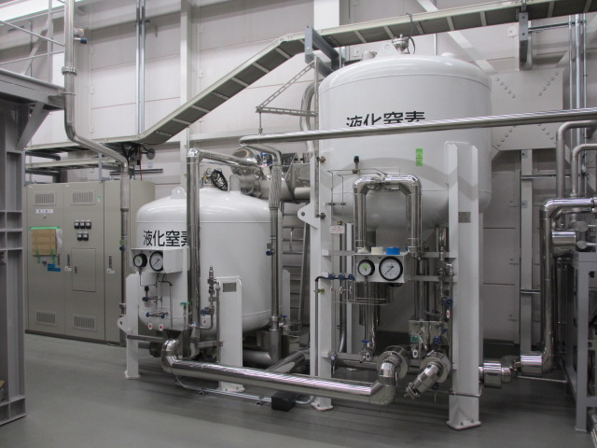
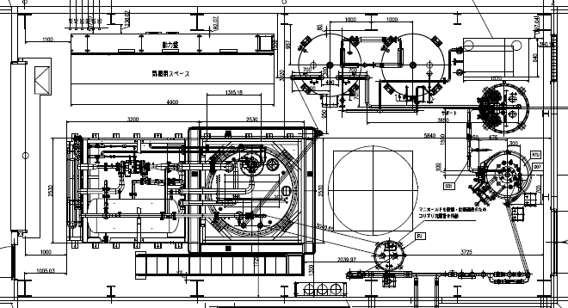
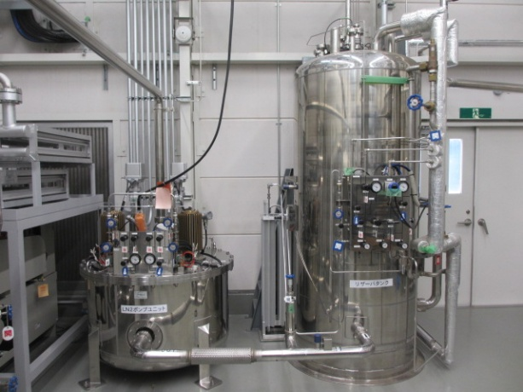
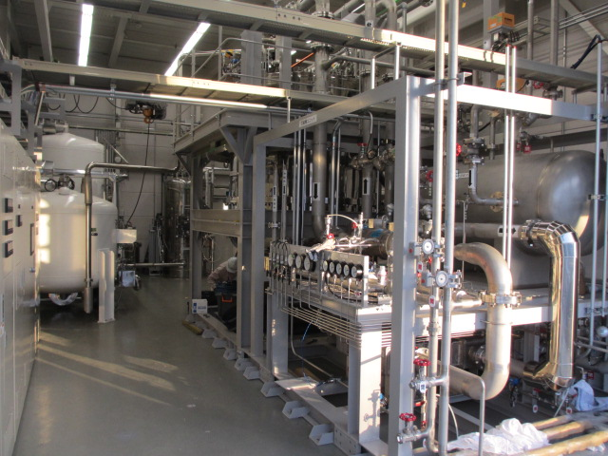
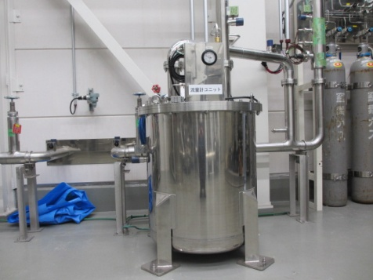

AC Transmission cable system
Brayton refrigerator cooling system
● Capacity is 5 kW
● COP 0.1
● Maintenance
interval is > 30,000 hours
Sub-cooler
(buck-up of
refrigerator)
Refrigerator
Pump
Unit
Flow meter
Reservoir
Notes:
11

Slide 12
DC Transmission cable system
●Purpose
To promote Commercialization of large capacity, low loss, long distance DC transmission cable system,
1)Verifying various characteristics using 1 km superconducting cable
system
2)Summarizing Guidelines on design, construction, operating, maintenance,
etc.
●Period：24 Jun 2016～28 Feb 2017 (8 months)
●Budget：200M yen （Subsidy 50%)
●Member：I-SPOT
（Chiyoda corp.,
Sumitomo Electrical Ind.,
Chubu Univ.,
Sakura Internet Inc.）
●Features
①Low heat intrusion
Straight tube : >1W/m
②Heat shrinkage
Helical deformation
③Multi-joints (two joints)
R & D Items | 1Q | 2Q | 3Q | 4Q
Item I
[1] Evaluation of liquid nitrogen circulation cooling performance simulating long distance
[2] Evaluation of conduction characteristics of superconducting cable system
[3] Evaluation by severe condition test
[4] Evaluation of long-term operation performance
[5] Residual performance confirmation test
Item II
Create design, operation and maintenance guidelines

Slide 13
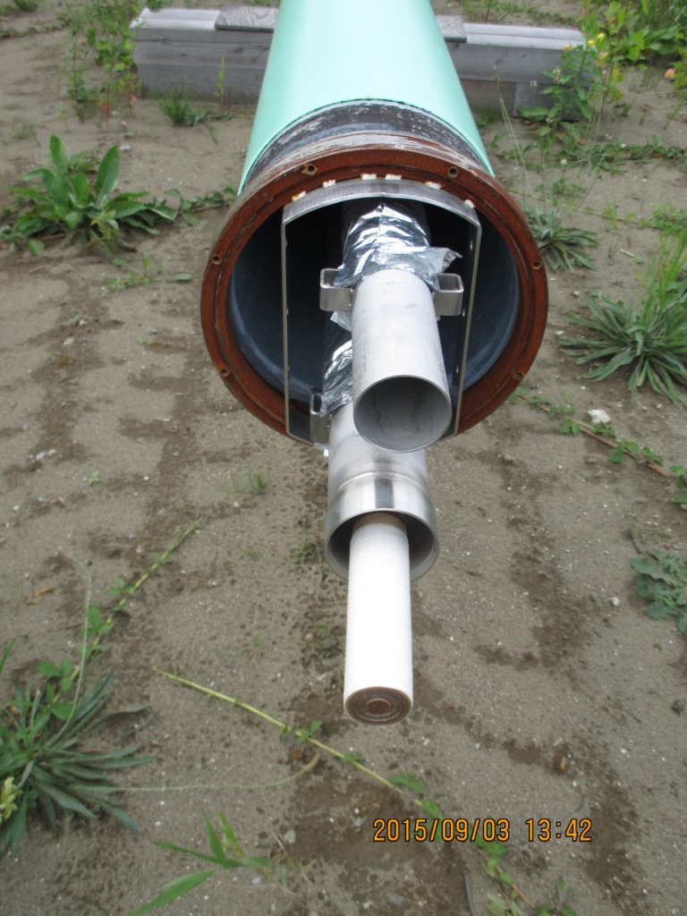
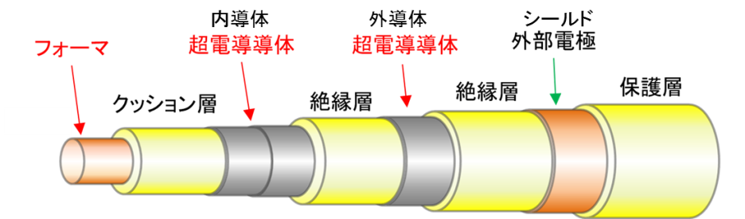
DC Transmission cable system
Section 2 : 125m
Nominal Current | ２５００A
Capacity | ５０MVA
Length | １０００ｍ
Cable Joint
CSJ
Cable Joint
NJ
Former Conductor Conductor Shield
Cushion
Insulation
Insulation
Protection
Section 1 : 468.8m
Section 3 : 372.5m
Return pipe SUS50A
Carbon steel pipe 300A
Support FRP
Shield Al
Heat Intrusion
>1W/m
Multi-Insulation
Cooler, Pump
Multi-Insulation
Cable pipe SUS65A
Cable
Terminal B Terminal A

Slide 14
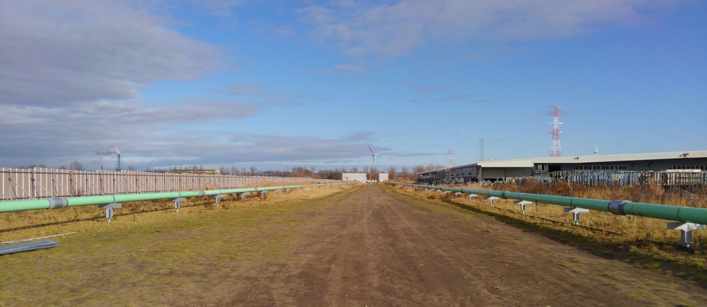
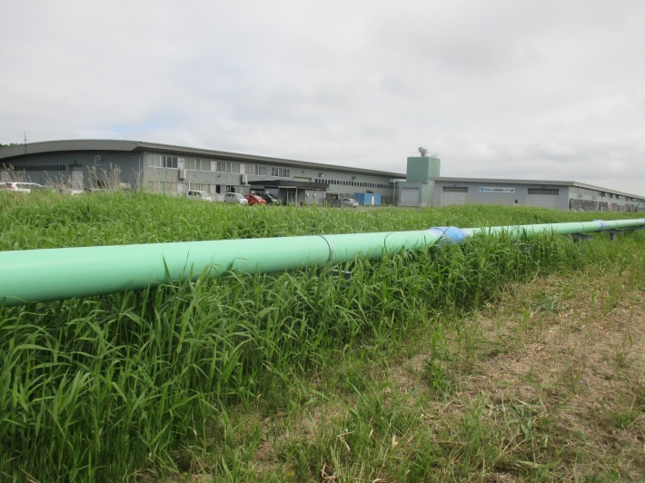
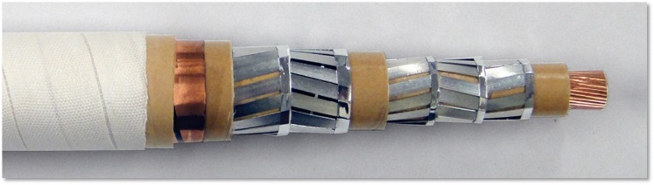
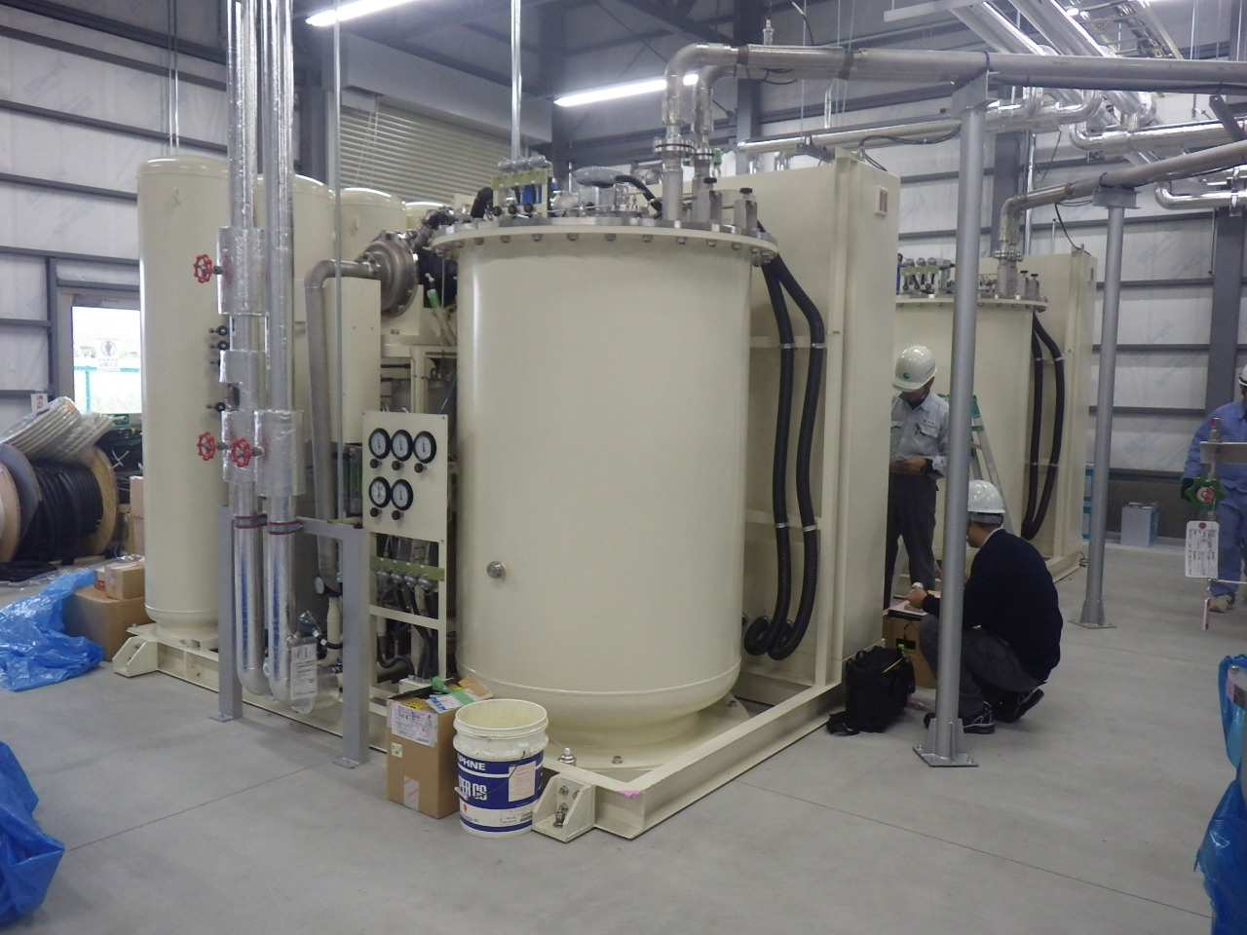
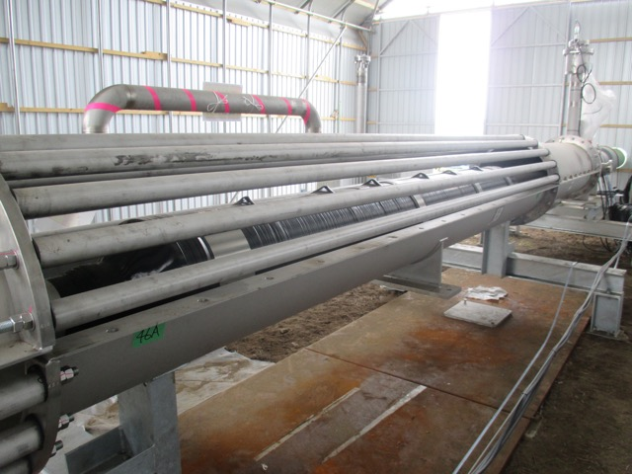
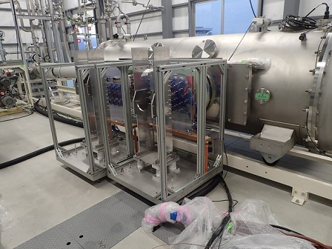
DC Transmission cable system
1km System
Pipe
Cable
Cooler system
Turbo Brayton 2kWx2+Starling 1kWx2
Cable joint
Terminal

Slide 15
DC Feeder cable system (Railway)
Background・Problem
Social Needs
・Promotion of development of fundamental superconducting technology
・Superconducting technology is expected to be applied to power transmission cables.
Especially social infrastructure such as railroad.
Issues in the railway site
・The power loss due to the resistance of conventional cables is large. ・There is no site to establish a substation when there is a demand for
enhancement of transport capacity, there is no countermeasure.
Effects
・To reduce the regeneration expiration and transmission loss. ・Voltage compensation effect.
・Consolidation of substations.
・Load leveling of substation and suppression of rail galvanic corrosion.
Realization of a compact long-distance cooling system that can be used at railway sites

Slide 16
DC Feeder cable system (Railway)
target
Items |  | 2016 |  | 2030
①Establishment km-class long cooling system
(１) | Compact size cooling system （RTRI, Meyekawa） | Installation volume 10 m³/kW | Installation volume 2 m³/kW
(２) | LN2 pump system （RTRI, IHI） | Head：0.3 MPa Flow rate：25 L/min | Head：0.6 MPa Flow rate：50 L/min
(３) | Insulation pipe technology development (RTRI, MESCO) | Heat intrusion： >4 W/m Regular evacuation | Heat intrusion ：2 W/m Once 1 year evacuation
②Establishment of design/evaluation/maintenance standard
(１) | Evaluation Technology （RTRI, Tokyo Univ.） | ― | Electric field analysis of current lead under nitrogen gas environment
(２) | Maintenance technology （RTRI, Kyushu Univ., Mie Univ.） | ― | Establishment of application guidelines for system maintenance technology

Slide 17
MRI magnet system
Development of a high temperature superconducting magnet system having high stable magnetic field
Main Objective
○Test producing 3T and 5T half size HTS coils for MRI
○Measurement of field uniformity and stability
○High current density coil (>200A/mm2 at 7T)
○Design of 3T whole body MRI magnet by HTS
The work will be held 2016-2020
Imaging to demonstrate high stable magnetic field and high homogeneous magnetic field
３T
５T
1st:2016~2018
2nd:2018~2020

Slide 18
MRI magnet system
Test half size 3T HTS coil for MRI
Specification of the half size 3T HTS Coil
Inner diameter | 580mm
Maximum outer diameter | 1200mm
Axial length | 980mm
Operating central field | 2.9T
Maximum field | Bzmax=4.2T,Brmax=2.9T
Current density of coil | 121A/mm2
Inductance | 145H
Stored energy at operation | 1.6MJ
Field uniformity on design | 1.7ppm/250mmDSV
Leak magnetic field area | 2.5mX3.4m (0.5mT)
Active shield coil
φ1200mm
φ580mm
L:980mm
Main coil
A design of a half size HTS 3T-coil
Cryostat will be designed next year.
Room bore is from 480mm to 500mmDia.
Imaging is a region of 150 mm or more in sphere

Slide 19
MRI magnet system
SUMMARY
○ As a next-generation MRI, we started the research and development of high stable magnetic field coil system fundamental technology using the ReBCO superconducting coil.
○ We promote the development aimed at imaging verification magnetic field of 3 T of stability less than 1ppm / hr and uniformity of 10ppm / 20mmDSV.
○ As a result, we successfully verified measures for issues in these particular subjects. World's first MRI Images of Mouse fetus using a HTS 3T Test Magnet at 2.9T were obtained.
○Advance research and development to solve problems related to the manufacture of large-diameter magnets and obtain highly stable magnetic fields as a next-step project for practical application of the high temperature superconducting coils.

Slide 20
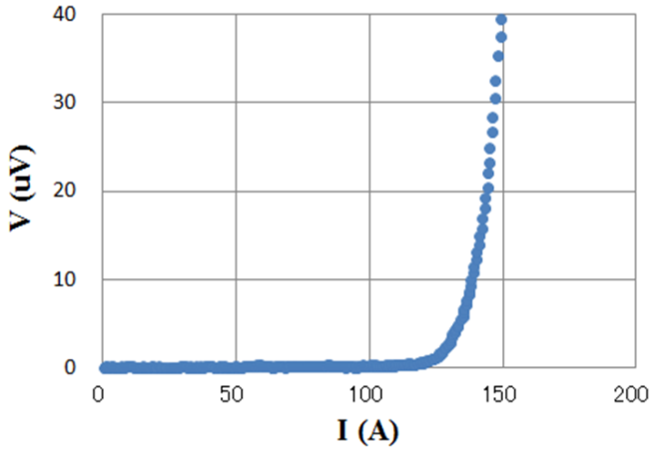
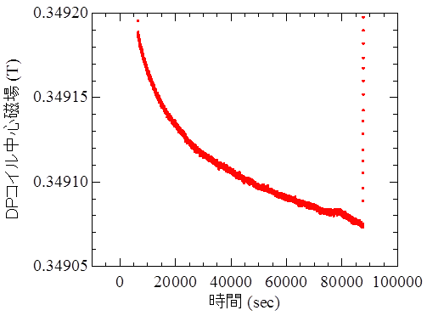
Development of HTS magnet systems with a high uniformity magnetic field
Completion of persistent mode technologies for a ３Ｔ HTS-MRI magnet
Achievement; HTS joint with the resistivity less than 10⁻¹²Ω
Target (2018)
Construction of a 1-Tesla REBCO solenoid coil with the HTS joints
Ic measurement
77 K
REBCO tape joint
HTS joint
PCS
Joint-R measurement
DC current
20 K
HTS DP coil
HTS solenoid coil
[Design: tentative]
1 Tesla
ID 120mm
OD 200mm
Length 200mm
Centerfield of DP coil [T]
2.5 x 10⁻¹²Ω
PCS
Heater
Time [sec]

Slide 21
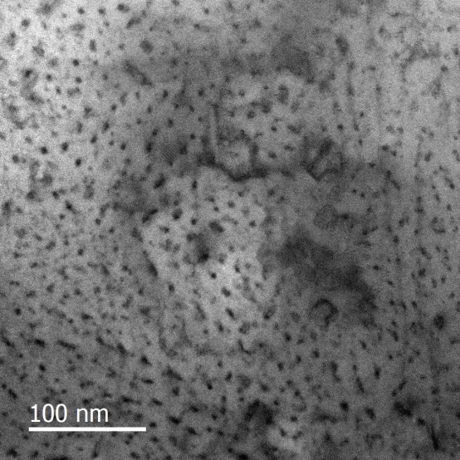



Improvement of HTS wire
High performance by artificial pinning centers
and structural factor optimization
Plan view
Cross sectional view
1.0μm
B // ab
B // c
100 nm
3-4nm dia.
~20nm
distance
I_{c}(B//c) ≠ Min. I_{c}
at higher temp.
corresponding
matching field
:5-7T

Slide 22

Improvement of HTS wire
Technology for improving uniformity of long wire performance
Reliability evaluation technology development
$$ln\left(ln{\left(1−F\right)}^{−1}\right)−\ln{V_{E}}=m\ln{σ_{c}}−m\ln{σ_{0}}$$
m=3.2
Cumulative failure
probability (1 mm³)
m=21
m=2.5
good agreement
～３MPa
～50MPa
Peeling strength characteristics of long wire

Slide 23


Improvement of HTS wire
Research and development of low loss structure wire for high magnetic field coil
Performance improvement of wire rod and simulation of electromagnetic response by thinning processing for low loss structure wire for high magnetic field coil
High performance thinning technique by scribing the superconducting tape wire
Considering the model (ρs ~ Jn - 1) of nonlinear resistance in superconducting thin wire and the normal conducting resistance (ρn) between fine wires, we simulate Maxwell equation numerically.
Filament I_{c}
To eliminate variations
J/J_{c}
Filament I_{c}(A)
Scribing tape wire
Current distribution of scribing tape wire
in collaboration with H. Zhang (Univ. Bath, UK)

Slide 24
Thank you for your attention.
Energy Conservation Technology Department
Notes:
ご清聴ありがとうございました。

